Slide 1


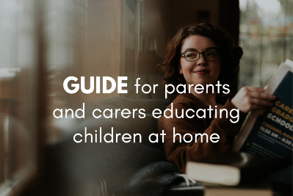


Before you start
Parents: read our helpful guidance before you get started
Mental health and emotional wellbeing
KS4
Home learning lesson 2:
Promoting emotional wellbeing
To start, play this slideshow from beginning

Slide 2
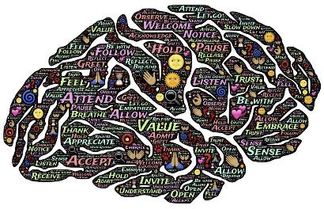
Home learning lesson 2:
Promoting emotional wellbeing

Slide 3



  We are learning:
  strategies to promote mental health and emotional wellbeing
  We will be able to:
  identify a range of strategies to promote emotional wellbeing
  evaluate the effectiveness of ways to promote mental and emotional wellbeing

Slide 4
You receive the messages below from a friend.
Write down what you might say to them.
Hey, have you seen loads of people have been talking about emotional wellbeing on the news?
They’re saying you can do stuff to look after your own emotional wellbeing. Any ideas?
?
Put your response to one side but keep it safe, you’ll need it at the end of the lesson

Slide 5

Diamond 9
Most effective strategy
What strategies are most effective for maintaining good emotional wellbeing ?
Use Resource 1 to rank the techniques in order of their effectiveness (either for yourself, or for people in general).
Put the strategy you think is most effective at the top, then the next two most effective, down to the one you think is least effective at the bottom.
Least effective strategy
Tip: If you can’t print these, then copy and paste each card into the diamond 9 template in Resource 1.

Slide 6
Diamond 9
Most effective strategy
There are many things people can do to support their mental health and emotional wellbeing.
These will be more or less effective depending upon the person and the situation.
If you have any other ideas for strategies, consider where these might sit in your diamond 9.
Least effective strategy

Slide 7
Evaluate strategies
Read the four strategy information slides that follow.
List three short key points about each strategy.
Rank each strategy from most to least effective (this is an individual judgement so there’s no one right answer).
If you would like a further challenge, research questions are provided for each strategy.

Slide 8

Spending time in nature
Some studies have found that being in nature may reduce feelings of anger, fear and stress, while improving mood and mental wellbeing. Being outdoors is thought to reduce stress by lowering the stress hormone cortisol. This means the rate of recovery from stress may be quicker in the natural environment than recovery from the same stressor indoors.
Aside from the benefits of spending time in nature or viewing scenes of nature on our wellbeing, taking time out of our days to go for a walk or activity gives overactive minds an opportunity to ‘switch off’.
Further investigation questions:
How long do people need to spend in nature for it to make a difference?
What alternatives are there to going for a walk in nature that might still provide similar benefits?

Slide 9
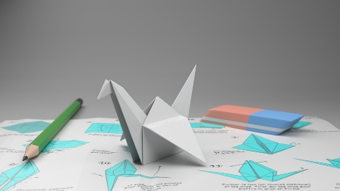
Arts and crafts
A 2009 collection of interviews noted benefits from many art-forms — including music, painting, drawing caricatures and poetry — on wellbeing. Many interviewees reported enjoyment from both practising the art-form itself and from the opportunities for social connection that taking part facilitated.
During times of stress, people sometimes find they have repeated, often negative, thoughts. Yet even when a person identifies this negative thinking pattern as unhelpful, it can be difficult to simply stop such thoughts. Diverting full attention to another activity (e.g. arts or crafts) can provide relief.
Further investigation questions:
How long do people need to spend on arts or crafts for it to make a difference?
What are some unusual arts and crafts which people might not know about or might not think about practising?

Slide 10
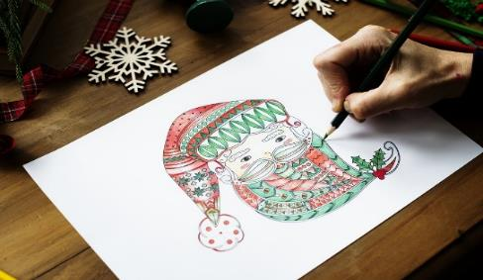
Mindfulness, including mindfulness meditation
Practising mindfulness encourages us to focus on the present by paying attention to our thoughts, feelings and body in a particular way. A study found that 8 weekly sessions of between 75-90 minutes’ mindfulness training led to an average drop of 20% in stress levels.
Using colouring books to calm the mind is supported by a clinical study, particularly when used in combination with other techniques such as deep breathing.
In mindfulness meditation, people focus on experiences in the present, such as the flow of breath, in order to be mindful of the moment. This trains them to acknowledge thoughts and emotions without judgement, which can be particularly helpful if someone experiences negative thinking loops. This can therefore lead to improvements in self-esteem and, by extension, resilience during times of difficulty
Further investigation questions:
What apps are available to support meditation?
How long is a person recommended to meditate for?

Slide 11

Exercise and dance
Regular exercise has been shown to improve mood and self-esteem whilst reducing stress and anxiety.
This is due to many factors, including the immediate impact of the endorphins (hormones) released during exercise, and the improvement in sleep quality following such activity. Studies have repeatedly shown that good quality sleep has been linked with improved mood.
Research compared young women who danced with those who did not and found a significant improvement in mood which lasted up to 8 months after the dance classes ended. Another study found that just one lively dance session can have a greater effect than vigorous exercise or listening to upbeat music.
Further investigation questions:
What forms of exercise are available that also promote mindfulness or meditation?
What opportunities to engage in exercise or dance are available to people at the moment?

Slide 12

Wellbeing toolkit
Create a wellbeing toolkit for yourself. Your toolkit could include:
a collection of photos, memes or crafts that lift your mood
a list of strategies you could use to support your wellbeing if things are difficult
a snapshot of people, places and websites that offer support and help.

Slide 13
Using the information from this lesson, revisit your response to a friend from the start of the lesson.
Hey, have you seen loads of people have been talking about emotional wellbeing on the news?
They’re saying you can do stuff to look after your own emotional wellbeing. Any ideas?
?

Slide 14

There are lots of places to get advice about emotional wellbeing or to discuss feelings.
ChildLine:
www.childline.org.uk Phone: 0800 1111
Young Minds:
www.youngminds.org.uk
Samaritans:
www.samaritans.org Phone: 116 123
In a crisis, text ‘Shout’ to 85258
Further support
If you have questions or concerns about emotional wellbeing or mental health, you can always speak to your parent or carer, or contact a teacher in school for more advice and support.

